Slide 1

PRESENTATION ON EXPLORATORY data analysis (credit eda case-study)
By:
Anshu Mani
Palliparicharya Mishra

Slide 2
CONTENTS
Introduction
Purpose
Business Objectives
Approach
Previous Loan Application Data Analysis
Case Study Conclusion

Slide 3
INTRODUCTION
This case study aims to identify patterns which indicate if a client has difficulty paying their installments which may be used for taking actions such as denying the loan, reducing the amount of loan, lending (to risky applicants) at a higher interest rate, etc. This will ensure that the consumers capable of repaying the loan are not rejected. Identification of such applicants using EDA is the aim of this case study. In other words, the company wants to understand the driving factors (or driver variables) behind loan default, i.e. the variables which are strong indicators of default.

Slide 4
PURPOSE
Credit risk analysis will help the company to make a decision for loan approval based on the applicant’s profile. Which controls loss of business to the company and avoid financial loss for the company.
As per criteria it’ll provide the loan to the merit list people and avoid the risk factor points.
When a client applies for a loan, there are four types of decisions that could be taken by the client/company):
Approved
Cancelled
Refused
Unused offer

Slide 5
BUSINESS OBJECTIVES
When the company receives a loan application, the company has to decide for loan approval based on the applicant’s profile. Two types of risks are associated with the bank’s decision:
If the applicant is likely to repay the loan, then not approving the loan results in a loss of business to the company
If the applicant is not likely to repay the loan, i.e. he/she is likely to default, then approving the loan may lead to a financial loss for the company.
The bank wants to understand the driving factors (or driver variables) behind loan default, i.e. the variables which are strong indicators of default. The bank can utilize this knowledge for its risk assessment.

Slide 6
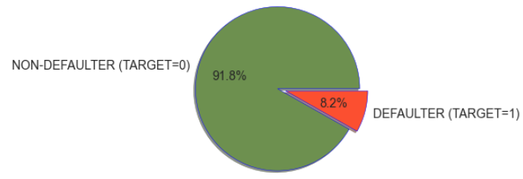
DATA IMBALANCE
Pie-Chart Representation:
Remarks : It is clear that there is an imbalance between the people who defaulted and who didn't default . More than 91% of people did not defaulted as opposed to 8 % of the people who defaulted.

Slide 7
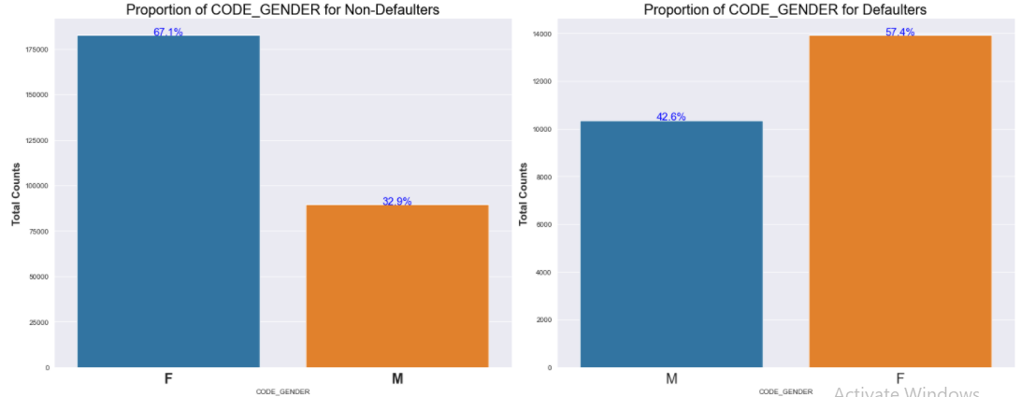
UNI-VARIATE ANALYSIS
1. Gender Proportion For Defaulters & Non-Defaulters :
Inferences :
We can see that Female clients are 67% in the case of non-defaulters and 57% in the case of defaulters.
More Female clients apply for loan than males and hence more the number of female defaulters as well.
The Rate of defaulting is lower among female clients than that of the male clients.

Slide 8
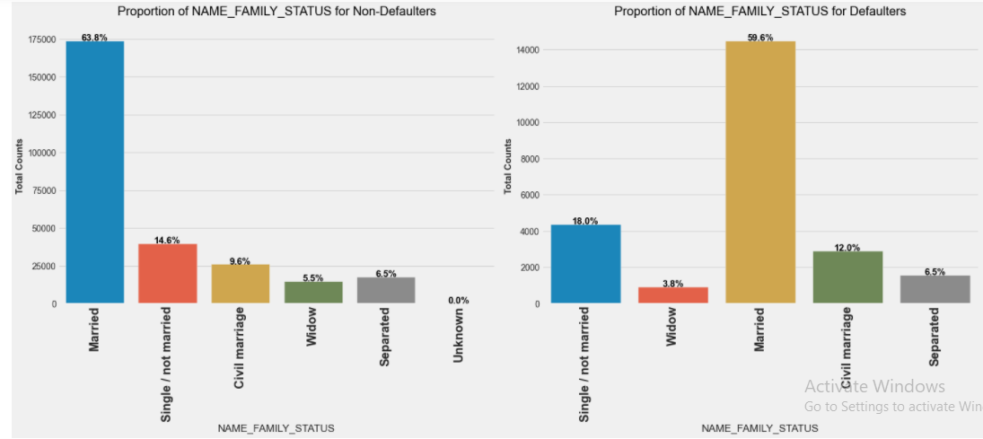
2. Family Status For Defaulters and Non-defaulters:
Inferences :
1. It is clear from the plot that married people tend to apply more for loan . Also they constitute the highest percentage among non-defaulters and defaulters.
2. widows are lowest in percentage for both non-defaulters and defaulters.
3. Also we can see from the graph that Single/not married constitute 14.6% in the case of non-defaulters and18% in the case of defaulters. So their rate of default is high and hence more risk associated with them.

Slide 9
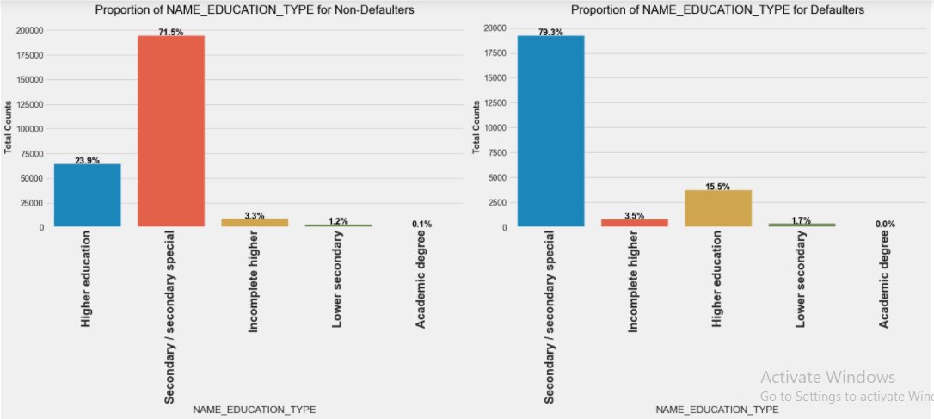
3. Education Type for Defaulters and Non-defaulters:
Inferences:
1.Clients with secondary and Higher Education constitute the highest percentage among non-defaulters as well as defaulters.
2.Clients with higher education or more are less likely to default . Secondary
educated people are most likely to default.
3. we can infer from the above plot that as the level of education increases
chances of default decreases.

Slide 10
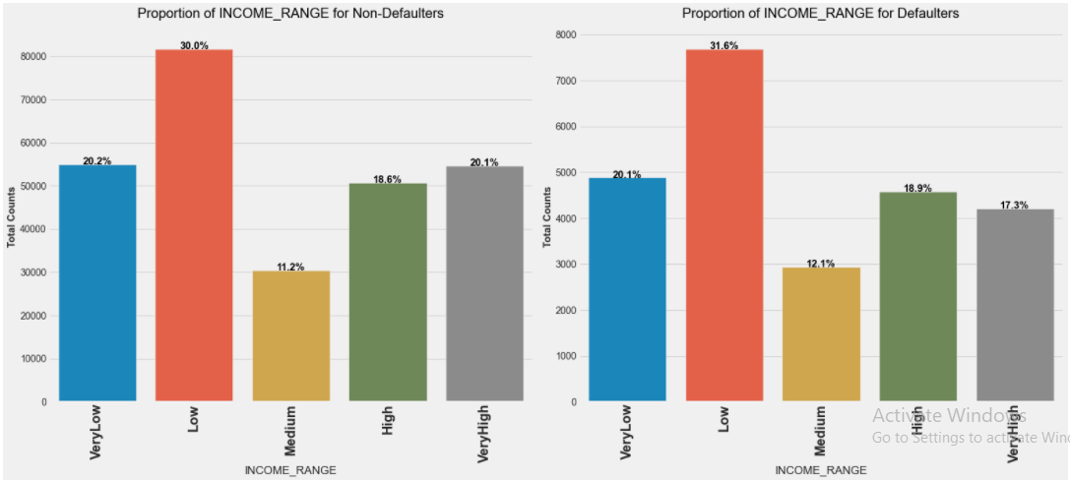
3. Income Range For Defaulters and Non-defaulters:
Inferences:
1.The very High income group has least rate of default. They constitute 17.3 %
in case of defaulters and 20.1% in case of non-defaulters, clearly having a low
default rate.
2. The low income group has more default rate followed by High income group

Slide 11
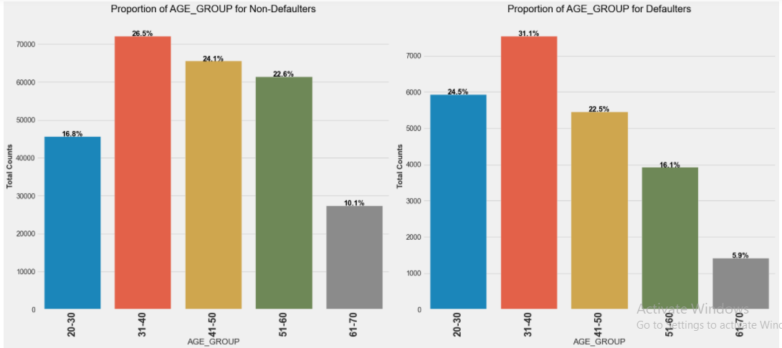
4. Age-Group Analysis for Defaulters and Non-defaulters:
Inferences:
1.We can see that people in the age group [21-30] have highest default rate , constituting 24.5% in case of defaulters as compared to only 16.8% in case of non-defaulters. so they
are riskiest people to give loan. This is followed by people in age group [31-40] who form the highest number of applicants.
2. With increase in Age, probably after 40 years the rate of default reduces. Possible reason could be , employment of people, increment in salary..

Slide 12
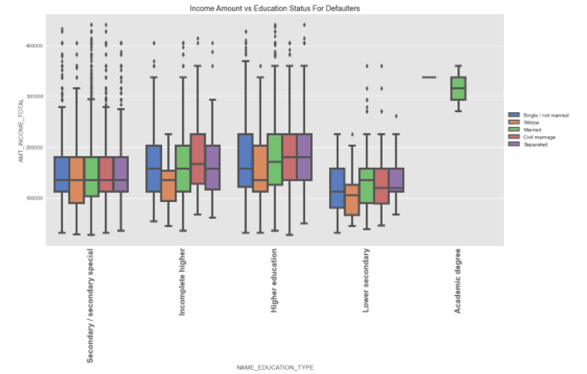
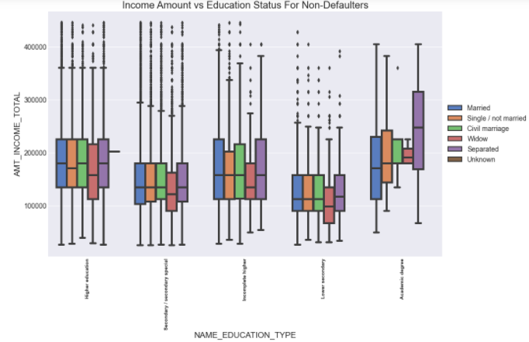
BI-VARIATE ANALYSIS
1.Income Amount Vs Education For Defaulters & Non-defaulters:
Inferences:
1.Clients holding Higher academic degree have high credit amount with Civil
Marriage being highest.
2.Clients having lower education tend to have a lower credit amount.
3. Married clients have highest credit amounts in all the education segments except
in Academic degree

Slide 13
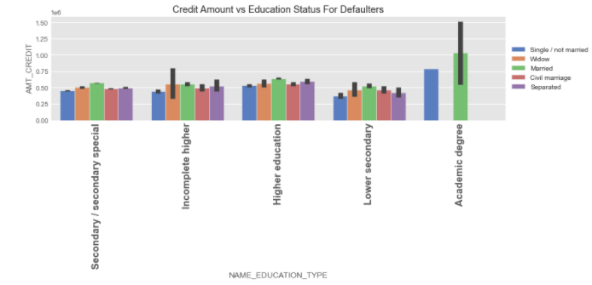
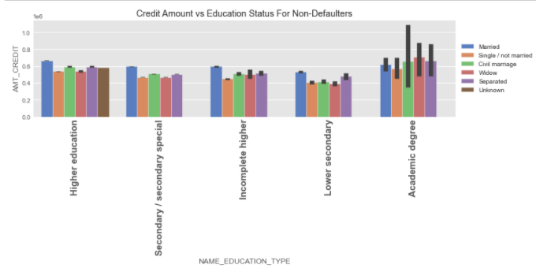
2.Credit Amount Vs Education For Defaulters & Non-defaulters
Inferences For Defaulters:
1. Married Academic Degree holding clients generally have a higher credit amount.
2. Clients having lower education tend to have a lower credit amount.
3. Across all education segments married clients have a higher credit amount.
Inferences For Non-defaulters:
1.Clients holding Higher academic degree have high credit amount with Civil
Marriage being highest.
2.Clients having lower education tend to have a lower credit amount.
3. Married clients have highest credit amounts in all the education segments except
in Academic degree

Slide 14
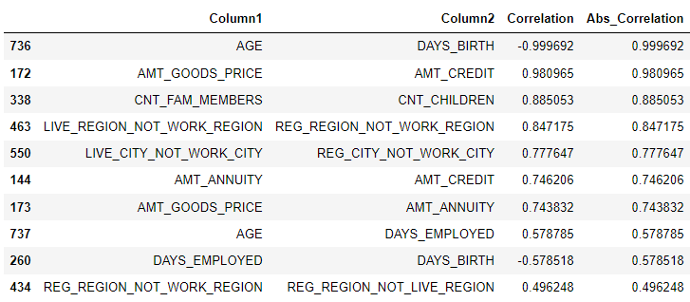
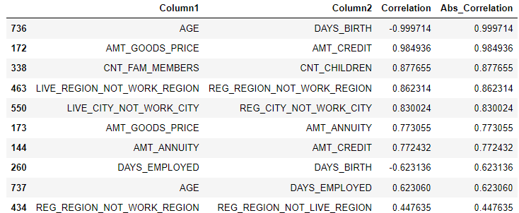
3.Top 10 correlations for Defaulters and Non-defaulters:
Defaulters Data
Non-defaulters Data
Analysis For Defaulters :
1. (AGE , DAYS_BIRTH) and (AMT_GOODS_PRICE , AMT_CREDIT) are highly correlated.
2. (AMT_ANNUITY , AMT_CREDIT) and (AMT_GOOD_PRICE ,AMT_ANNUITY) are
moderately correlated.
3. AGE, DAYS_EMPLOYED are poorly correlated.
Analysis For Non-defaulters:
1.(AGE , DAYS_BIRTH) and (AMT_GOODS_PRICE , AMT_CREDIT) are highly
correlated.
2. (AMT_ANNUITY , AMT_CREDIT) and (AMT_GOOD_PRICE , AMT_ANNUITY) are
moderately correlated.
3. (DAYS_EMPLOYED , DAYS_BIRTH) and (AGE , DAYS_EMPLOYED) are poorly
correlated.

Slide 15
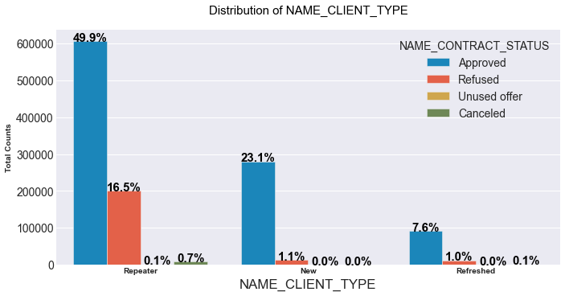
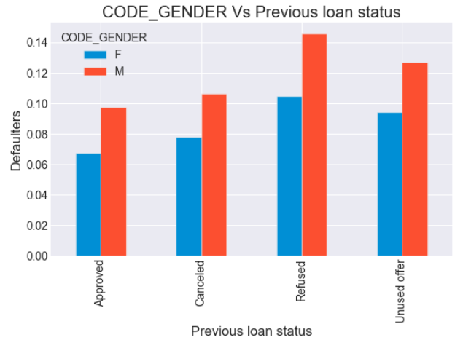
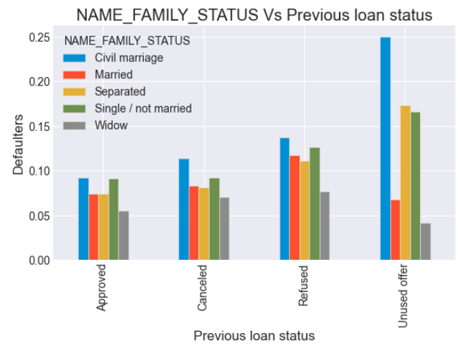
I. PREVIOUS LOAN APPLICATION DATA ANALYSIS :
Clients who did civil marriage with previously unused loan offers have defaulted most. They are follwed by clients who are either single or separated.N APPLICATION DATA ANALYSIS :
Inferences For Client-Type:
1.Repeater clients are highest in number, but only 49% gets accepted.
2.Repeater clients also get refused most often with a refusal percentage of 16.5 %
Inferences For Code_Gender vs Previous Loan-status:
1.Male clients have defaulted more than female clients . Banks can give more weightage
to female clients while approving loans.
2. Previously refused clients have defaulted more on current application.
Inferences For Name_Family_Status vs Previous loan status:
1.Clients who did civil marriage with previously unused loan offers have defaulted most. They are follwed by clients who are either single or separated.

Slide 16
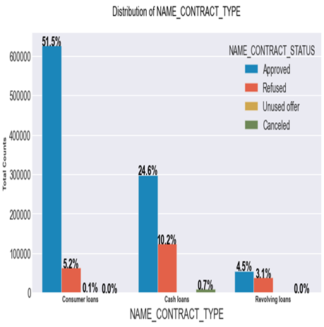
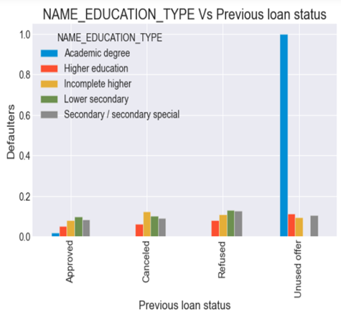
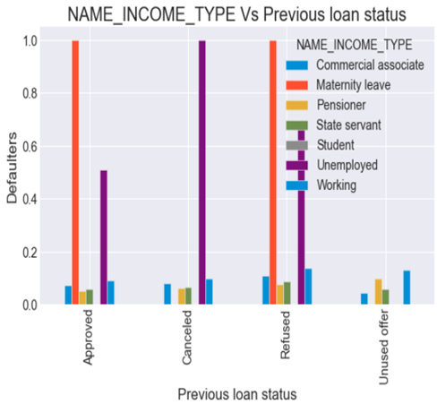
II.PREVIOUS LOAN APPLICATION DATA ANALYSIS :
Inferences For Name Contract Type :
1.Most applications are for consumer and cash loans.
2. Cash loans have highest refusal percentage(10.2%)
Inferences For Name Education Type vs Previous Loan Status:
1.Previously refused clients with lower secondary or secondary education tend to default more in current application.
2.Although used loan offer shows highest bar for academic, but it may be due to fact the number of client with academic degree is very small in number as compared to other clients.
Inferences For Name Income Type Vs Previous loan status:
1.Working commercial associate and pensioner form a majority of applicants who applied for loan while students, unemployed and maternity leave are small in number, so their analysis won't be fruitful and might lead to biased results.
2. Working applicants seem to form the highest number of defaulters.

Slide 17
CASE STUDY CONCLUSION
Although most of the clients who applied for loan are female, the default rate is higher in the case of male clients.
People belonging to Income type 'Working' form almost 61 % of the defaulters. This means they had payment diffculties and banks should do proper check of working clients and take actions like reducing the loan amount or lending at higher interest.
Banks should give more weightage to clients with 'Higher education' as they seem to default less as compared to people with Secondary level of education . clients with 'Secondary' or lower level of education experience more payment diffculties , also they get refused more.
Clients in Age group [21-30] have highest default rate .While clients with age > 40 years experience less payment difficulties , possibly because they get financially stable. So Banks should do properly scrutiny of clients in age group 21-30 and possibly reduce the loan amount.
6.38 % of previously approved loan applicants defaulted the current loan and 72 % of previously refused loan applicants were able to pay their current loan.
This indicates wrong decisions were made by the bank in these cases.
THANK YOU

